Slide 1
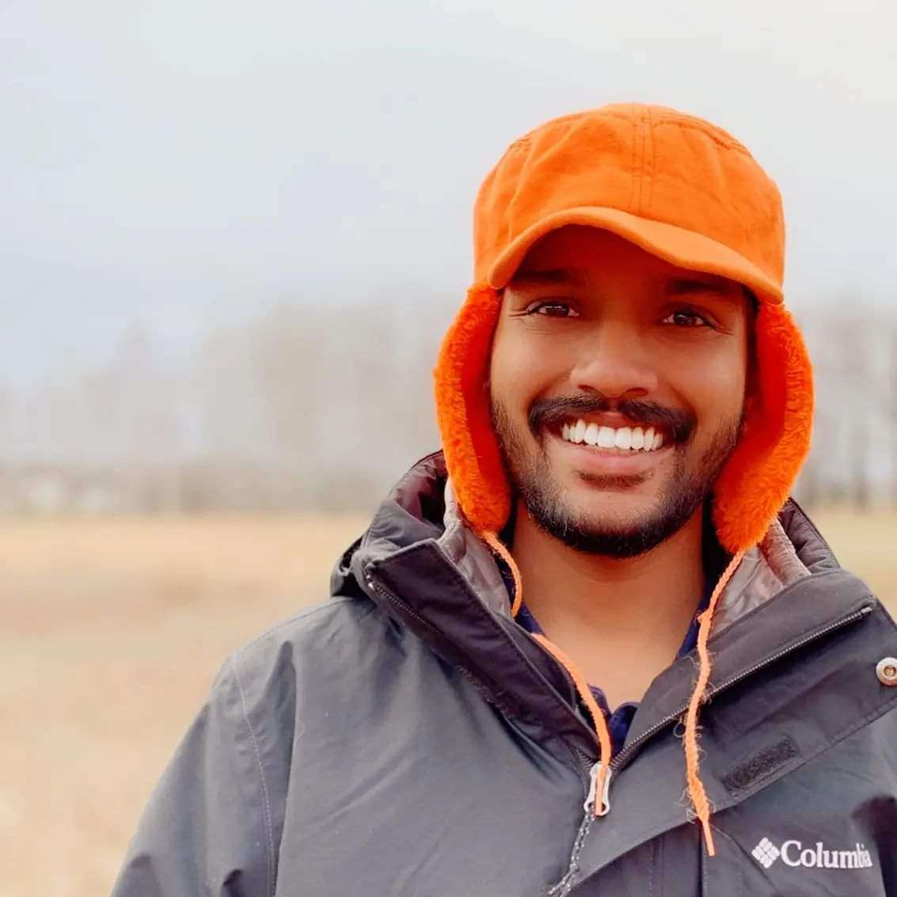


Passive Microwave Retrieval of Snow Density using SMAP Satellite observations
By Group 4 - Silas Kati, Divya Kumawat, Destiny Ziebol
Notes:
Hi everyone, the research topic for our class project is Passive Microwave Retrieval of Snow density using SMAP satellite observations.

Slide 2
Contents
Introduction and Motivation
Problem Statement
Hypothesis and Project Aims
Dataset
Proposed Methods
Evaluation plan

Slide 3
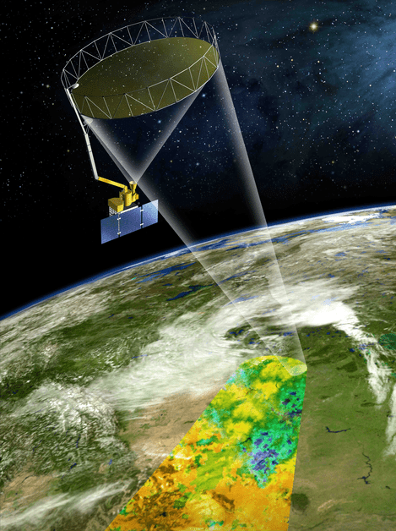
Introduction and Motivation
What is the SMAP Satellite?
The Soil Moisture Active Passive (SMAP) mission is an orbiting observatory that measures the soil moisture and vegetation optical depth (VOD) everywhere on Earth.
The SMAP satellite was launched in 2015 by NASA. It operates at 1.4 Ghz (L-band microwave frequency) at a resolution of 9km*9km.
This satellite helps solve major environmental problems such as weather forecasting, predicting floods and droughts, and crop yield forecasting.
Motivation
Recently, it has been discovered that the observed signal by this satellite is sensitive to snow density as well.
This new discovery creates opportunity to develop a product of snow density observations across the world.
Notes:
Let me first briefly introduce the SMAP satellite and then describe the motivation behind this topic.
The SMAP satellite was launched by NASA in 2015, with a mission to observe soil moisture and vegetation in terms of the Vegetation Optical Depth metric across the globe. Since then this satellite has been playing a critical role in solving many major environmental problems such as helping weather forecasters predict flash floods, farmers grow more crops and communities better plan for drought.
This is a passive satellite meaning it senses the radiation emitted by the earth unlike Active sensors which send and then receive the reflected emission signal back from the surface.
This satellite operates at a microwave frequency of 1.4 GHz, also called L-band. The SMAP satellite operates at a 9Km * 9Km grid resolution, and covers the surface of the earth every 2-3 days.
It was thought that L-band satellite data are unaffected by snow but recently it was discovered that snow does affect the emission signal and hence this opens a new possibility to use SMAP’s emission signal data to observe snow density and vod on frozen soils.

Slide 4
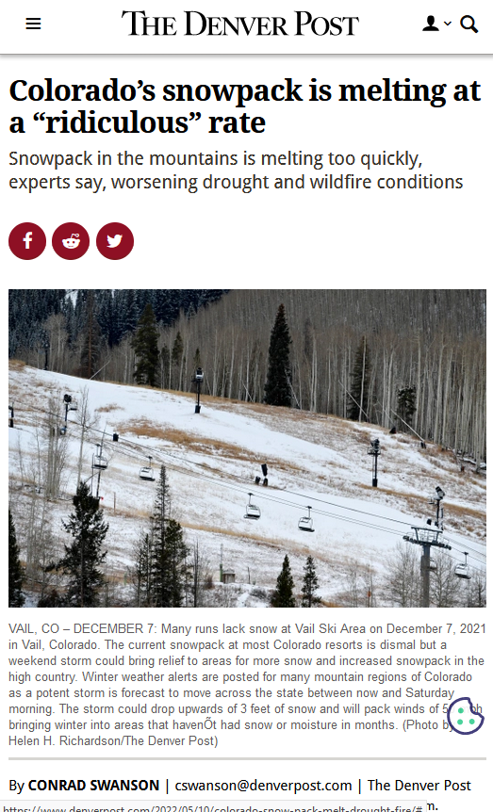
Background
Why is Snow density important?
Energy Cycles
Fresh water access
Climate monitoring
Natural Disaster prediction such as floods and avalanches.
Notes:
Now one might ask, why snow density is important.
Seasonal snow cover occupies an important position in the global surface energy balance, hydrological cycle, and climate system.
It accounts for approximately 50% of the land area in winter in the Northern Hemisphere, as well as provides fresh water for one-sixth of the world’s population.
Snow density is an important variable of snowpack, which influences the thermal, mechanical, and optical properties of snow layers.
And hence knowing snow density can help us in predicting natural disasters such as floods, avalanches, and snowstorms, establishing hydrological models, as well as water resources management.
Image credit: https://www.denverpost.com/2022/05/10/colorado-snow-pack-melt-drought-fire/

Slide 5
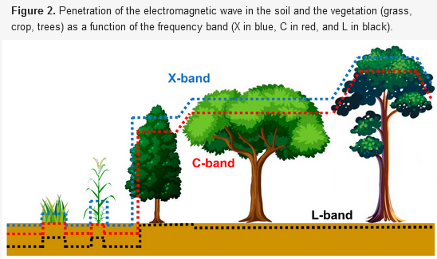
Background
Why is VOD (Vegetation Optical Depth) important?
VOD is a microwave based vegetation parameter that captures vegetation water content. It is calculated from the scatter of microwaves as they bounce off vegetation and return to the satellite.
VOD is robust - cloud cover has minimal impact.
VOD compliments existing measures - such as NDVI and LAI.
VOD is useful - gives you key input for analysing crop growth.
Global Monitoring of the Vegetation Dynamics from the Vegetation Optical Depth (VOD): A Review. Frappart et al, 2020. Remote Sens. 12, 2915; doi:10.3390/rs12182915
Notes:
The importance of vegetation optical depth (VOD) has been well established in recent years.
Imagine an alternative satellite vegetation index where cloud cover is not a problem (unlike in MODIS satellite data) one that you can always rely on, anywhere in the world.
VOD is a microwave-based vegetation parameter that captures vegetation water content.
Compared to vegetation indices derived from reflectance acquired by sensors operating in the visible and the infra-red domains, VOD is not affected by the presence of clouds and less sensitive to the presence of water in the atmosphere.
VOD is retrieved from both passive and active microwave remote observations, and we have a long-term record of the vegetation dynamics over land surfaces since 1978. It has been shown in many studies that VOD offers complementary information to the commonly used vegetation indices derived from multi-spectral images such as NDVI and LAI, and It presents several advantages compared to these indices. VOD gives you key input for analysing crop growth, (invaluable for farmers and digital farming platforms), yield prediction (invaluable for commodity traders and humanitarian aid) and drought proxies.

Slide 6
Problem Statement
Currently, Ground observation data is used to understand the spatiotemporal heterogeneity of snow density, but it is difficult to achieve large-scale monitoring due to the complex environment and limited number of the stations.
There are no global observation products of snow density and vegetation optical depth (VOD).
SMAP satellite data currently includes freeze/thaw state, but does not monitor snow density.
Notes:
Motivated by the these observations, we propose to address following three problems in this study:
SMAP satellite data currently includes freeze/thaw state, but does not monitor snow density. So It can increase the applicability of the satellite data.

Slide 7
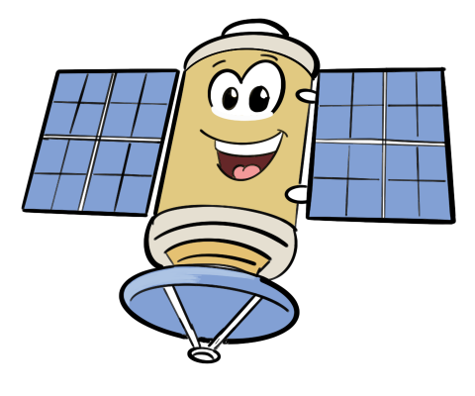
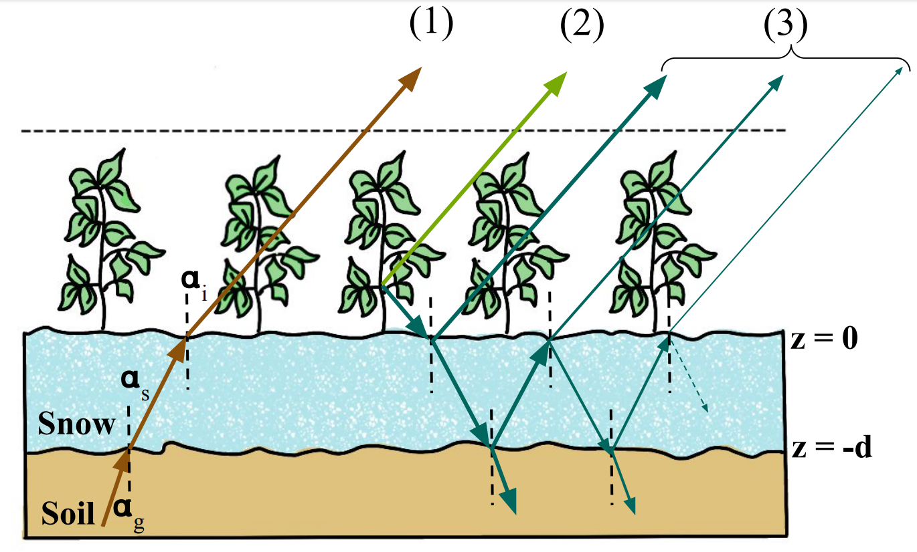
Hypothesis
We hypothesize that Snow Density can be sensed in the L-band. The rationale is that dry snow is a low-loss medium in L-band, which will affect how much signal is received by the satellite from underlying soil.
2-S EM Physics Based Model
Notes:
So in this study we hypothesize that: Snow Density can be sensed in L-band. The rationale is that the dry snow is a low-loss medium in L-band i.e snow does not emit or absorb signal from the underlying soil, but it still does affects the signal due to the phenomenon of refraction.
Hence the signal observed by the satellite will be sensitive to snow density.
And this behaviour is simulated by the physics based model called 2 Stream Emission model.
Extra: Soil emits a signal received by the satellite. Snow refracts this signal, with higher density changing the angle more acutely. This changes how much signal can be received by the satellite, which will always receive signal at a fixed angle.

Slide 8
Abstract Representation of the Physical Model
Forward Modeling: Given input driver and system characteristic , learn to predict output
Input/ Driver Features (x_{t}):
(i) Snow Density
(ii) Vegetation Optical Depth
(ii) Ground Temperature
(iv) Temperature of Vegetation
Output (y_{t}) :
(i) Brightness Temperature (horizontal polarization)
(ii) Brightness Temperature (vertical Polarization)
Forward Model
F (x_{t} , s)
Input/ Static Features (s):
(ii) Roughness Coefficient
(iii) Single scattering albedo
Notes:
This is abstract representation of the forward model where we have input or driver features which affects the observation in presence of the static model parameters which are characteristic to a particular pixel and does not change with time.
For the input drivers, we have Snow Density, Vegetation optical depth (VOD), ground temperature and temperature of vegetation.
Static parameters include roughness coefficient of the ground and single scattering albedo of the vegetation.
We will get two observations from the model commonly known as brightness temperature at horizontal and vertical polarization after feeding the input parameters and static parameters into the forward model.

Slide 9
Abstract Representation of the Physical Model
Inverse Modeling: Given observation (y_{t}) and static characteristic (s_{t}) , determine the input drivers (x_{t})
Inverse Modeling
Input/ Driver Features (x_{t}):
(i) Snow Density
(ii) Vegetation Optical Depth
(ii) Ground Temperature
(iv) Temperature of Vegetation
Output (y_{t}) :
(i) Brightness Temperature- horizontal polarization)
(ii) Brightness Temperature (vertical Polarization)
Forward Model
F (x_{t} , s)
Input/ Static Features (s):
(i) Roughness Coefficient
(ii) Single scattering albedo
Notes:
Now as we have described, we are interested in predicting snow density and vegetation optical depth using the satellite observations.
So in this inverse modeling framework we are interested in Input parameters given the observations from the satellite and a priori information for all other parameters.
And we aim to solve this inverse problem framework using Deep Learning Techniques.

Slide 10
Project Proposal
We will:
Attempt to solve the inverse problem of predicting snow density and VOD by using machine learning techniques.
Analyze the importance of each input feature in the retrieval model.
Expand our model to include time series analysis by taking advantage of the annual snow density variation over years as well as the interannual variability of density.
Notes:
So, In this class project we will

Slide 11
Dataset
SMAP Satellite Data:
Brightness Temperature (Horizontal Polarization)
Brightness Temperature (Vertical Polarization)
Soil Temperature
Roughness Coefficient
Single Scattering Albedo
Reanalysis Data (ERA5):
Snow Temperature
MODIS Satellite:
NDVI Data
Physics Based Model
2-S EM model (Two- Stream Emission Model)
Notes:
The Dataset which we will be using for this project will include SMAP satellite observations commonly known as brightness temperature and other ancillary information such as soil temperature, roughness coefficient and single scattering albedo. We will obtain the snow temperature from the ERA 5 reanalysis data and NDVI data from MODIS satellite data.
We will also use the physics based forward model called Two- stream emission model to incorporate physics of the problem in our planned machine learning approaches.

Slide 12
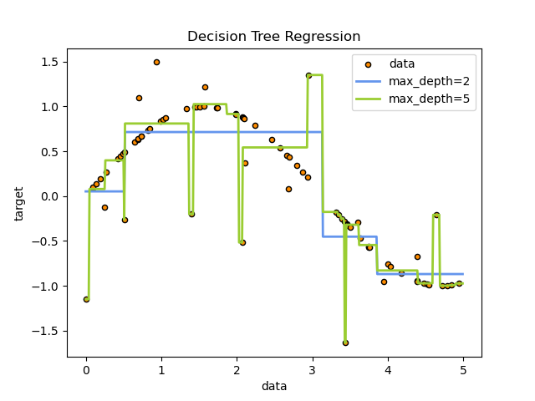
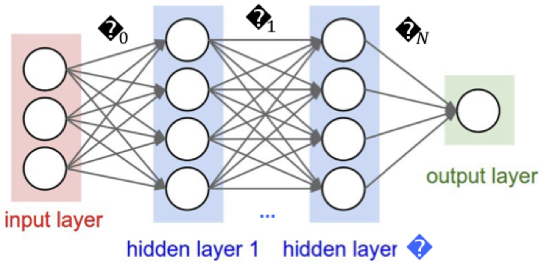
Methods
Dataset preprocessing
Cleaning
Spatial Resolution matching of our datasets
Modeling Ideas
Simple
Decision Tree Regression
Ridge Regression
Complex
Neural Network
Neural Networks with Physical model incorporated
Pre-trained Neural Network using physics based model simulations.
Notes:
Our methods will include
Playing and organising the data which may include cleaning of the data such as filtering out unusable values, flattening into tables and also spatial resolution matching
We initially plan on trying simple modeling methods like Decision Tree Regression and Ridge regression as have been implemented in a couple of related papers we have seen. Based on the results we obtain, we plan on improving by implementing more complex methods such as neural networks, KGML, and pre-trained networks.
Image Credit: https://scikit-learn.org/stable/auto_examples/tree/plot_tree_regression.html

Slide 13
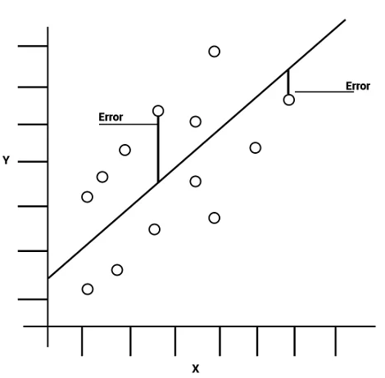
Experimentation Analysis
Performance
Errors
MSE, RMSE, RMSLE
Accuracy
R²
Comparison
Performance
compared to physical model, ground truth when available.
Training process
Which model architectures perform best, can we increase performance with physics guided models?
https://www.simplilearn.com/tutorials/statistics-tutorial/mean-squared-error
Notes:
Once we have implemented some models we plan on trying to evaluate them on the basis of performance, primarily their error rate in terms of MSE, RMSE, and RMSLE, and their accuracy in terms of R squared as the other papers have.
We also plan on comparing the implemented models to each other, and we plan on doing first on the basis of performance against the physical model and any ground truth data when available. We will then compare models on the basis of their architecture and training method.

Slide 14
Possible Roadblocks and Challenges
Poor results
Is there alternate pre-processing to try?
Rethinking the choice of models
RNN vs CNN vs DNN
Pre-trained physics based model
Potentially look at more data
We could include historical weather data, raw input bands from MODIS, etc.
Notes:
Coming to the possible roadblocks we may face.
Our poor results can be conceptualized as significantly worse performance than the physical model. We would like to see comparable results between physical and ML models. Density and VOD should be comparable to actual ground truth in both cases.
Alternate architectures may need to be explored depending on the results we get. Additionally, KGML approaches can also be applied to increase accuracy.
Nevertheless, we may also end up needing to find and include new datasets such as weather, reanalysis data, or raw inputs from MODIS as we work on this because the problem we are trying to solve on is a novel approach.

Slide 15
Thank you for watching!
Stay tuned for our next update,
Group 4: Silas Kati, Divya Kumawat, Destiny Ziebol
Notes:
With that, we end our presentation and are open to discussions and questions you may have.

